Slide 2
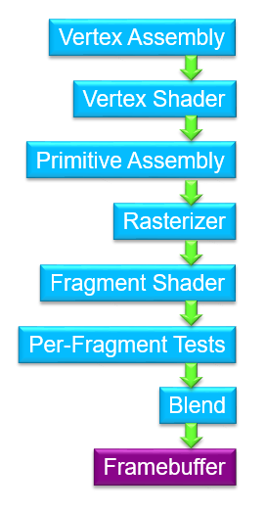
Vertex Transform and Assembly
Primitive Assembly
Core Rasterization
Pixel Shading
Updating frame buffer

